Slide 1

Title of Project:
SummarEase – AI PDF Summarizer and Assistant
JSPM’s
Rajarshi Shahu College of Engineering, Tathawade, Pune
(An Empower Autonomous Institute under Savitribai Phule Pune University)
Department of Computer Science and Business Systems
Artificial Intelligence Mini Project
AY-2025-26
Student Name:
1. Pramay M. Wankhade (RBT23CB013)
Faculty Name: Prof. Parul Rajwade

Slide 2
Introduction
Objective of the Project:
Develop an AI-based tool to summarize lengthy PDF documents efficiently.
Enable interactive Q&A and quiz generation for better understanding.
Provide reference-linked summaries to maintain content context.
Enhance productivity by reducing reading time and improving knowledge accessibility.
Scope:
Automates document summarization and exploration using AI & NLP.
Allows PDF upload, text extraction, summarization, and Q&A in one interface.
Useful for students, faculties, researchers, educators, and professionals.
Scalable to include multi-document support and multilingual summarization.
Mapping With SDG Goal: SDG 4 – Quality Education
Ensure inclusive and equitable quality education and promote lifelong learning opportunities for all.
Key Features:
Smart Summarization – Generate concise or detailed summaries.
Interactive Q&A – Ask AI about document contents.
Reference-Linked Summaries – Trace back to the original text.
Quiz Generation – Auto-generate quizzes from content.
PDF Viewer – Read and highlight extracted text.
Export Options – Save summaries and Q&A sessions.

Slide 3
Algorithm Used
Chosen Algorithm: Transformer-based Language Model (Gemini API)
Reason for Selection:
  Uses Transformer-based architecture capable of understanding context and generating coherent, human-like summaries.
  Easily integrates with Streamlit via Gemini API, offering high accuracy and adaptability for summarization and Q&A tasks.
Advantages:
  Efficient Performance: Handles large text data with optimized attention mechanisms for faster summarization.
  Easy Implementation: Simplifies text analysis through ready-to-use APIs without requiring local model training.
  Context Awareness: Maintains meaning and context across long passages, improving summary quality.
  Scalable & Reliable: Backed by Google’s cloud infrastructure ensuring stability and scalability.

Slide 4
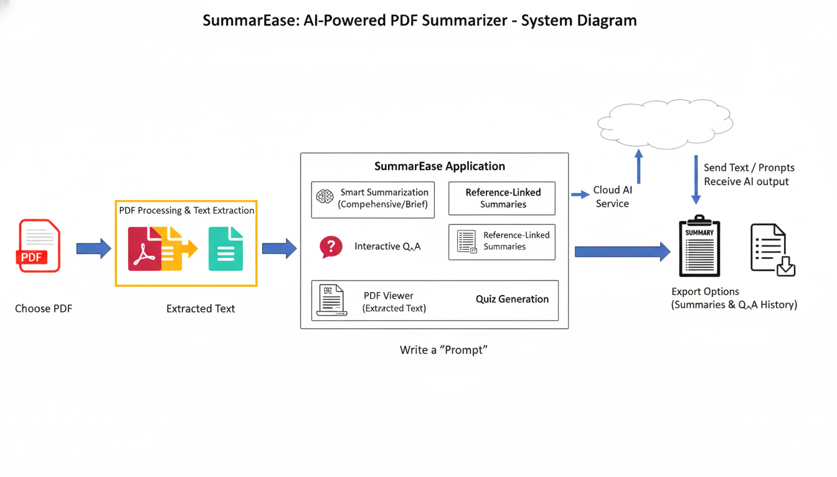

Slide 5
Module
1️⃣ PDF Text Extraction Module
Extracts text content from uploaded PDFs using PyPDF2.
Reads pages sequentially and cleans text for further processing.
2️⃣ Summarization Module
Uses Google Generative AI (Gemini API) to generate concise or detailed summaries.
Sends extracted text as input and retrieves context-aware output.
3️⃣ Q&A Module
Enables users to ask questions based on PDF content.
Gemini AI provides relevant, context-based answers.
4️⃣ Quiz Generation Module
Automatically generates quiz questions (MCQs/short answers) from summarized content.
Helps users test their understanding.
5️⃣ User Interface Module
Developed using Streamlit for an interactive web experience.
Handles PDF upload, summary display, Q&A, and quiz interface.

Slide 6
Methodology & Results
Methodology:
1. Problem analysis
  Identified the need for an AI-based system to summarize and analyze lengthy PDF documents efficiently.
2. Algorithm design & coding
  Implemented Transformer-based Gemini AI for summarization, Q&A, and quiz generation.
  Integrated modules using Python and Streamlit for user interaction.
4. Testing & validation
  Verified text extraction, summary accuracy, and response relevance across multiple documents.
  Ensured smooth performance and user-friendly interface.
• Results & Conclusion:
  Achieved accurate, concise summaries and interactive document exploration
  Improved productivity by reducing reading and comprehension time
Future scope: Integration of advanced GUI, database connectivity, offline functionality, and intelligent caching for faster and seamless user experience.

Slide 7
References
Google Generative AI (Gemini) – https://ai.google.dev
PyPDF2 – Documentations – (https://pypdf2.readthedocs.io/en/3.x/)
NinethSense oWnZ mE (document-summarizer-using-open-ai-on-langchain)
PDF-summarizer-chatbot-using-LLaMa2

